Slide 1
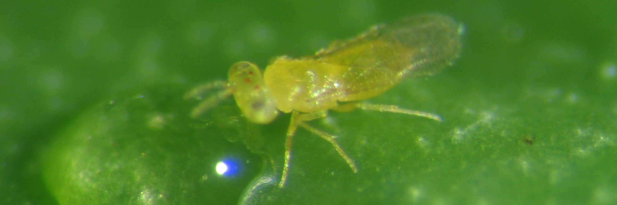
Comparative ecology of sexual and asexual parasitoid wasps
Cyril Matthey-Doret
Supervised by Casper Van Der Kooi
Directed by Tanja Schwander
Notes:
ADD: UNIVERSITY OF LAUSANNE

Slide 2
Background
In general, few species reproduce asexually
Hypotheses predict asexual and sexual species to differ in host range and geographical distribution.
Never tested on a large scale analysis
Many asexual species in certain clades of haplodiploid arthropods
Notes:
REMOVE FIRST POINT. INSTEAD GIVE EXAMPLE ABOUT HOST/COUNTRY BETWEEN SEX AND ASEX. USE A FIGURE TO EXPLAIN WHAT YOU MEAN. MAYBE THE FIGURE ABOUT APTINOTHRIPS RUFUS FROM MY 2014 EVOLUTION PAPER?

Slide 3
The study
Gather data on different ecological variables for species in Chalcidoidea.
Compare those variables between parthenogenetic and sexual species.
Notes:
HERE PUT RESEARCH QUESTIONS INSTEAD: DO ASEXUALS HAVE DIFFERENT ECOLOGIES AND/OR DISTRIBUTION RANGES? THEN THE TWO SUBQUESTIONS.

Slide 4
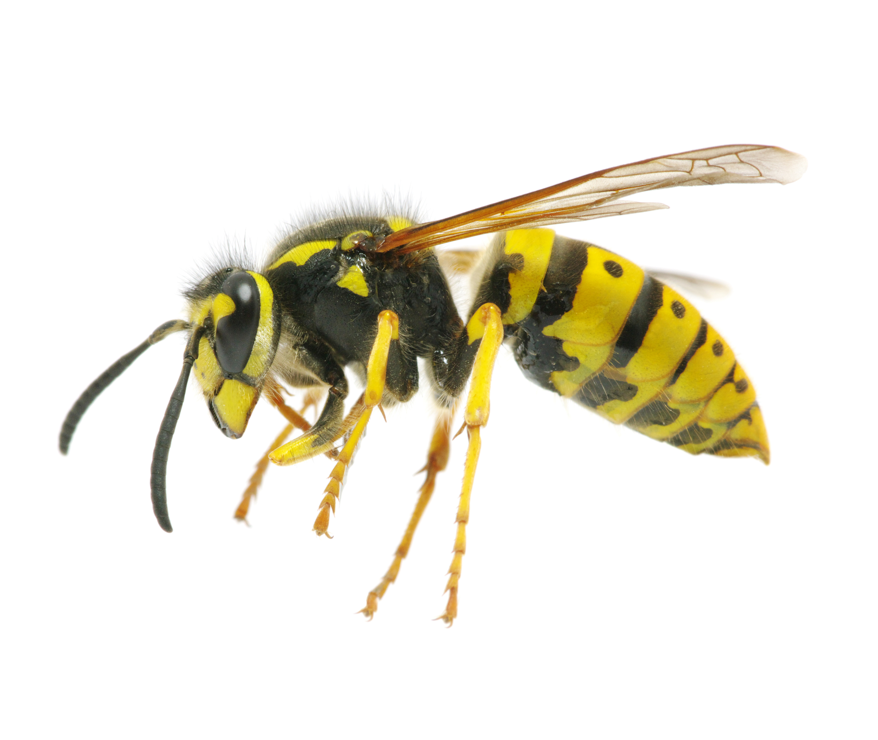
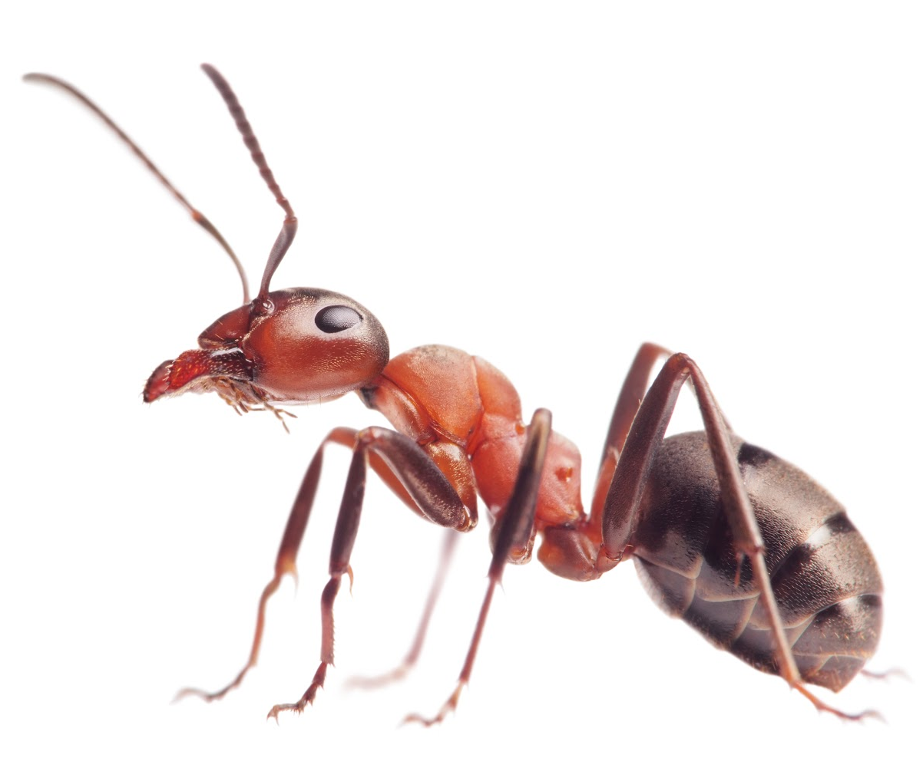

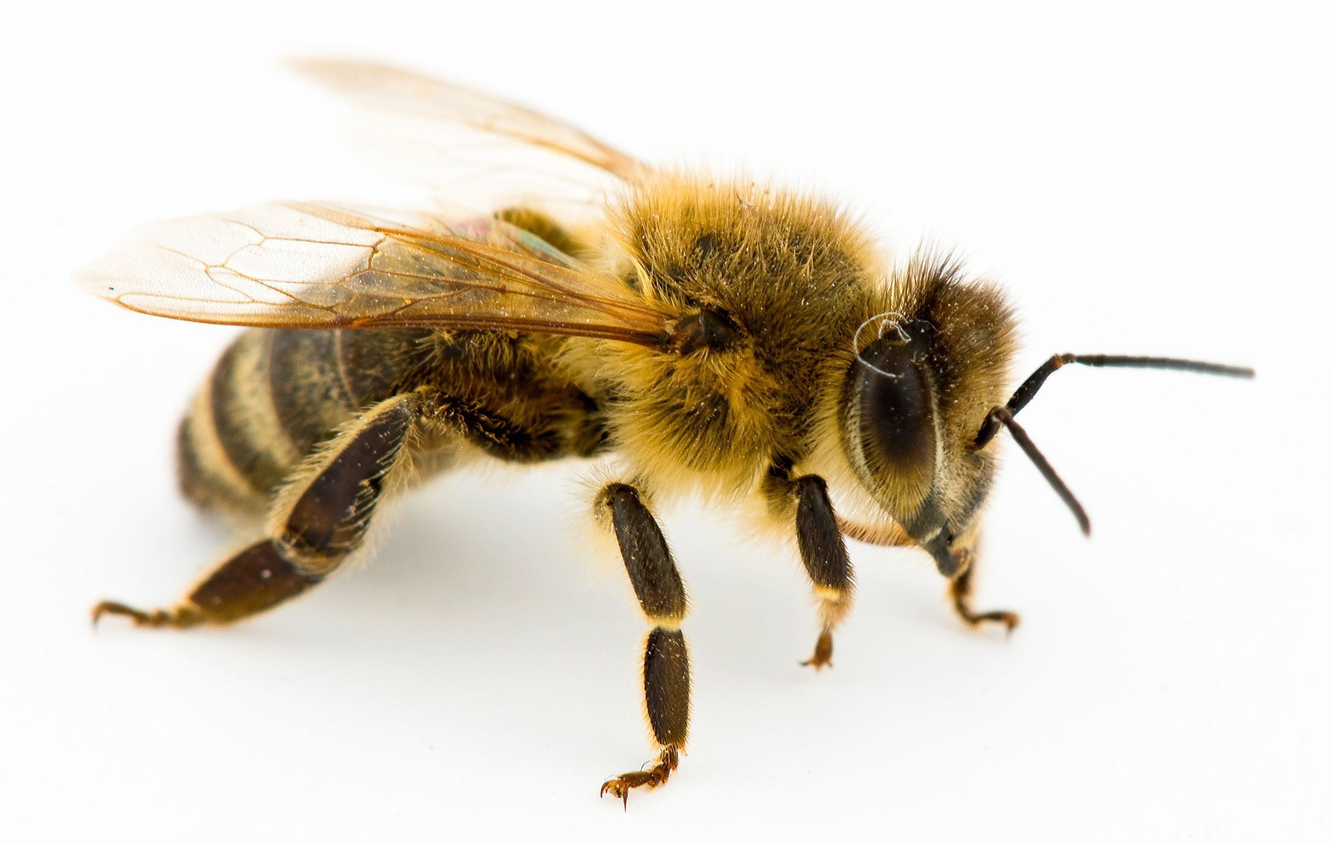
Haplodiploid arthropods
Occurs in many insect species
Offspring can develop without egg fertilization (parthenogenetically)
sexual
asexual
+
Notes:
MAYBE THIS SLIDE IS NOT NECESSARY (PUT IT IN THE SUPPLEMENT). YOU DON’T CARE ABOUT THE SEX DET SYSTEM REALLY AND BY DEFINITION HYMENOPTERA ARE HAPLODIPLOID.

Slide 5
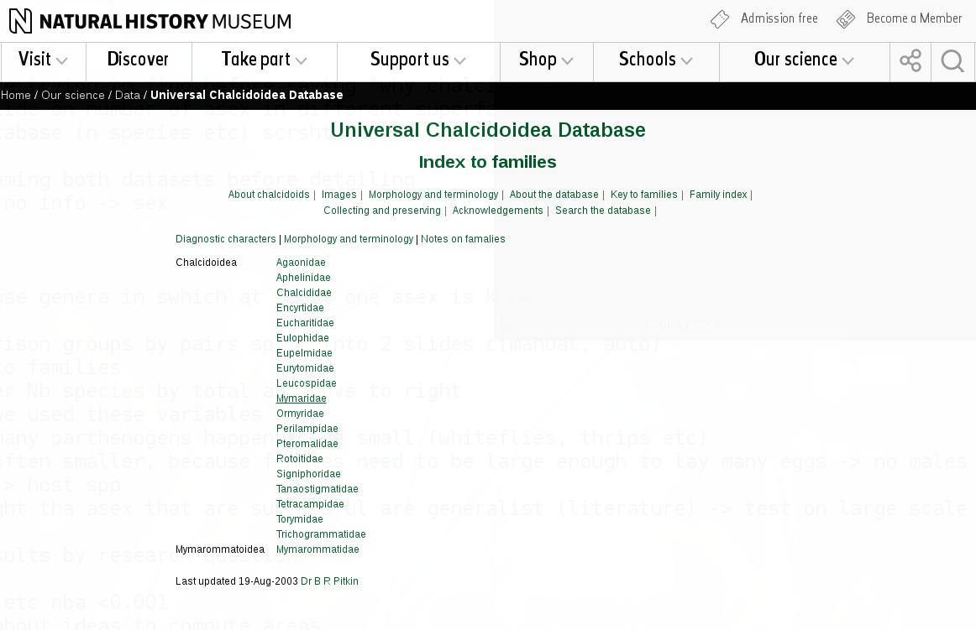
Why Chalcidoidea ?
Many (240) parthenogenetic species
Well studied, many species relevant for biocontrol.
Great database available!
Records for ~31'000 species of Chalcidoidea
host species and distribution

Slide 6


Manual dataset
Gathered by hand in literature
Few species
Comparison sex vs asex between the most closely related species.
Automated dataset
All data from the same database
Many species
Comparing asex vs sex in each genera
Genus
Pair 1
Pair 2
Family
Notes:
MERGE THIS SLIDE WITH THE FOLLOWING ONE. PUT THE TOTAL SPECIES AND PAIRS IN THIS ONE.

Slide 7
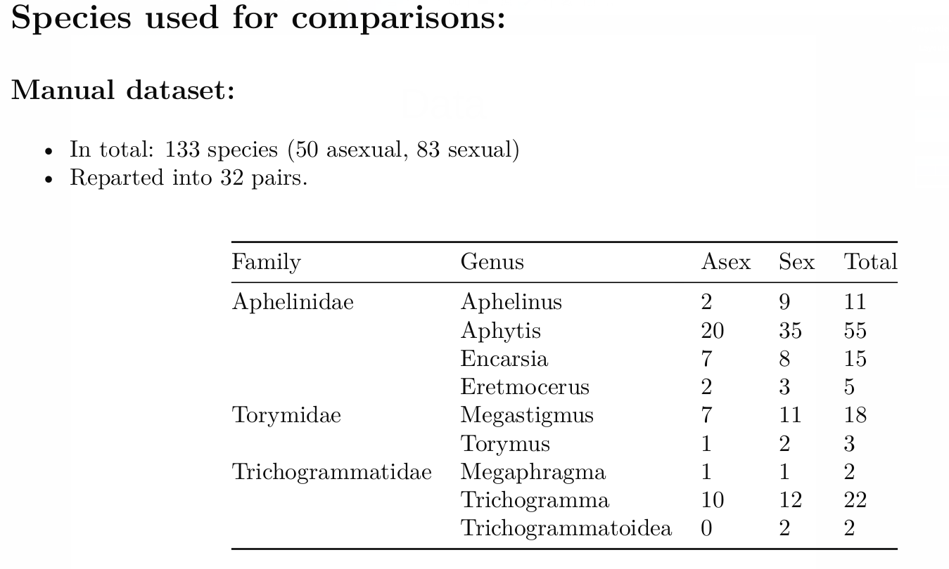
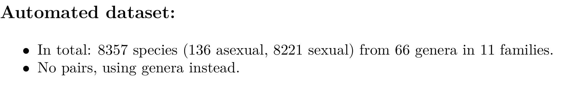
Data overview

Slide 8
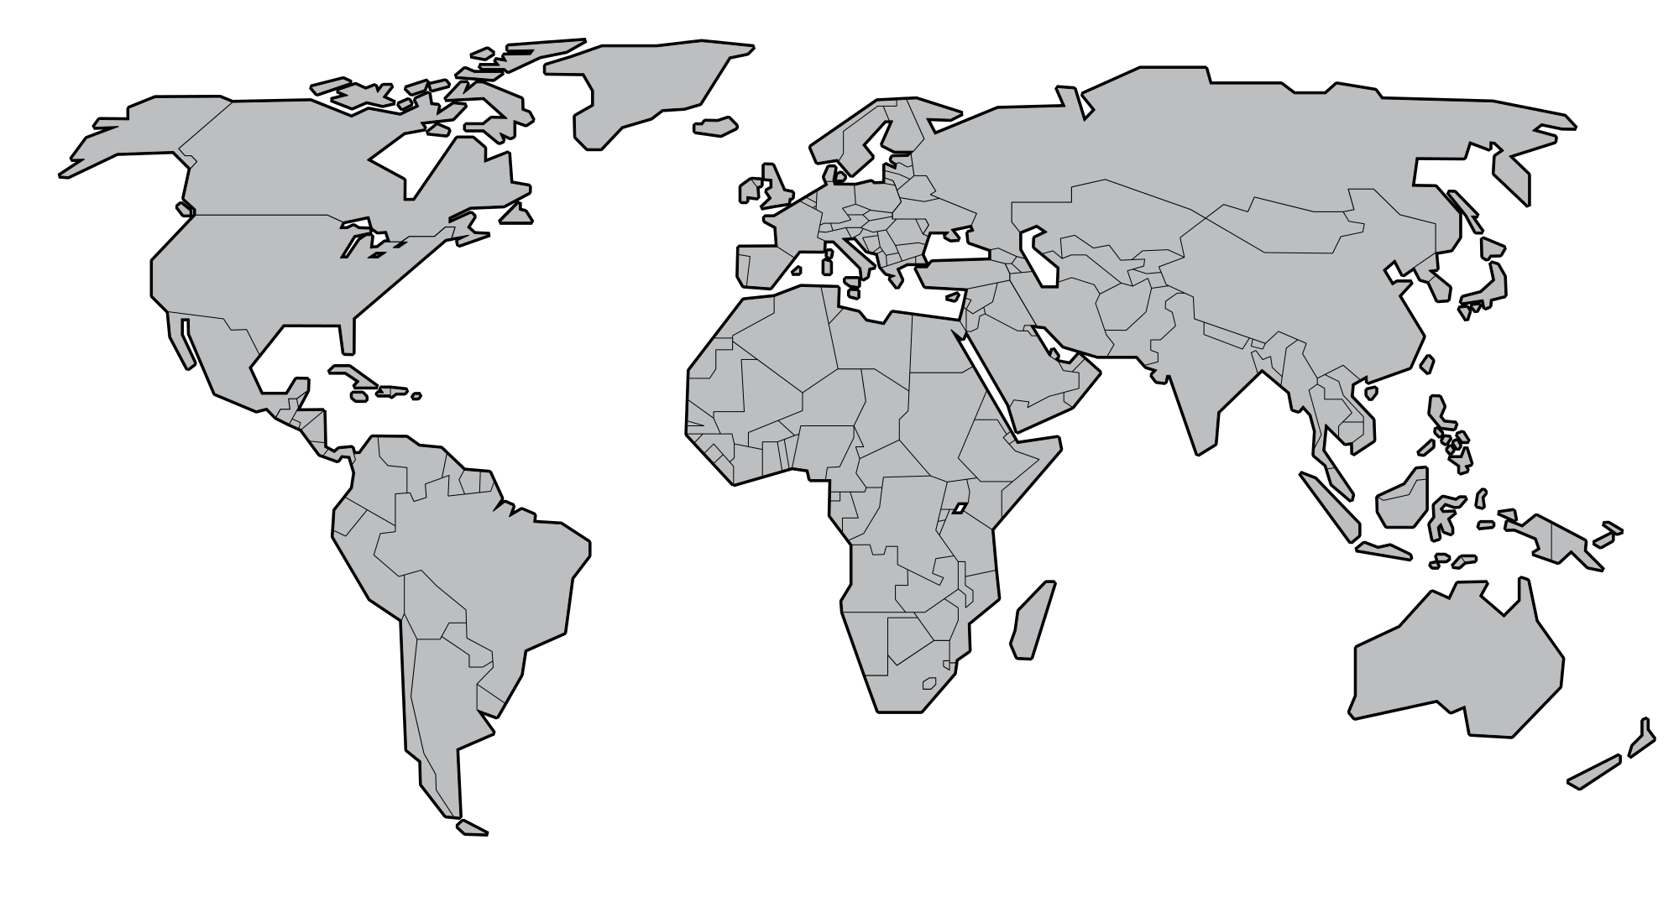
Variables studied
Do asexuals tend to have more host species ?
Successful asexuals are often generalist.
Number of host species
Do asexuals tend to occupy larger regions than sexuals ?
Number of countries/states
Geographical distribution in more detail using latitude.
Max distance from equator.
Min distance from equator
Latitude range

Slide 9
Statistical analysis
Using generalized linear mixed models:
Manual: y ~ mode + (1| genus / pair)
Automated: y ~ mode + (1| genus)
Using permutations approach to reduce poor distribution fitting bias.

Slide 10
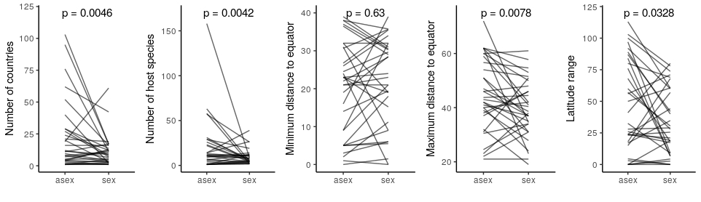
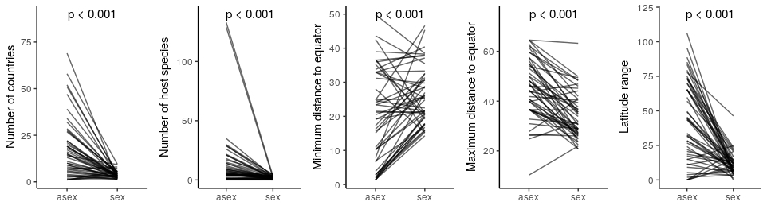
Results
Manual dataset: values per pair
Automated dataset: values per genus

Slide 11
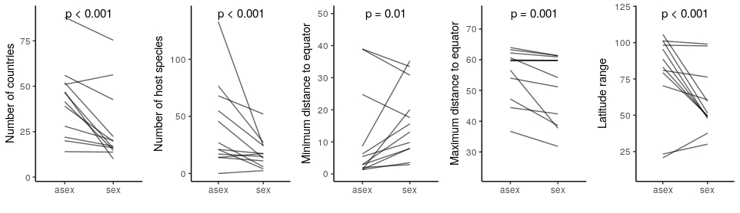
Automated dataset: Publication bias
Poorly studied species have unknown reproductive mode and were considered sexual
Sexual species will have fewer known hosts and countries
Results are consistent when excluding poorly studied species (more than 10 publications)
Notes:
I think this should go to the supplement. In the main figures you put a sentence: “results robust with respect to publication bias”.

Slide 12




Arrow of causality
Does the broad niche evolve after transition to asexuality?
Or are sexuals with broad ecologies and distributions more likely to give rise to asexuals?
Sex
Asex
Sex
Asex
Sex
Asex
Notes:
PUT A QUESTION AS TITLE

Slide 13
Arrow of causality
Combining manual and automated datasets
Genus X
Genus X
Sister species
outgroup
vs
Comparing number of host species and countries between sister species and outgroups in each genera
Notes:
MAKE THE COLORS THE SAME, AS IT IS THE SAME GENUS.

Slide 14
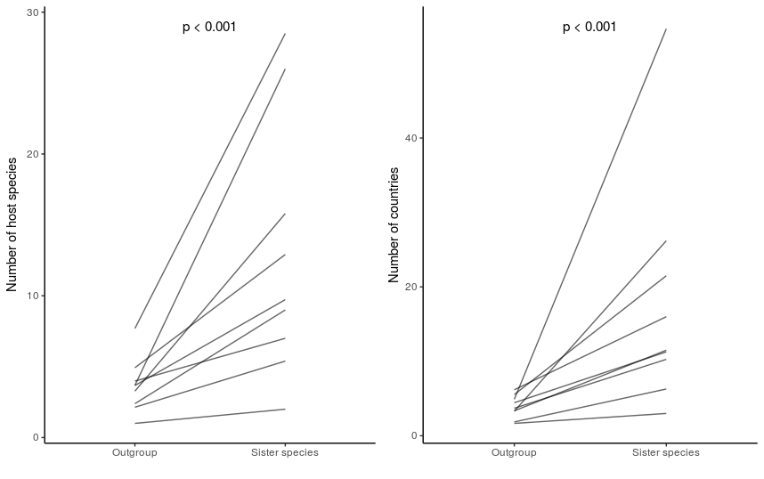
Causality: Results
Sexual species from which asexual sister species diverged already had a large niche
Notes:
THE TITLE IS MEANINGLESS, INSTEAD PUT THE SENTENCE AS TITEL (THAT’S YOUR RESULT)

Slide 15
Results: summary
Asexuals have wider niches:
More host species than sexuals
Sampled in more countries
Their geographical distributions can expand more towards poles.
Asexuals arise from already widely distributed sexual species.
Asexual
Sexual
Notes:
TITLE SHOULD BE: CONCLUSIONS. The colored circles are very clear. I would remove the southern hemisphere figure, as we don’t really have species from there. Then cut off a bit of S-America to make it not look to empty.

Slide 16
Thank you !
Questions ?
Notes:
REMOVE THIS SLIDE OR MAKE IT NICER. I WOULD REMOVE IT, AS YOU CAN JUST ASK THE AUDIENCE IF THEY HAVE QUESTIONS

Slide 17
Supplementary slides

Slide 18



Manual dataset: flowchart
Host range
Body length
Pairs
Distribution

Slide 19
Manual dataset: Data

Slide 20



Automated dataset: flowchart
Only genera with at least one known parthenogen were used.
Nominatim:
Extracting coordinates
Stored for analysis
NHM Database
Host range
Distribution
Distribution
Host range

Slide 21
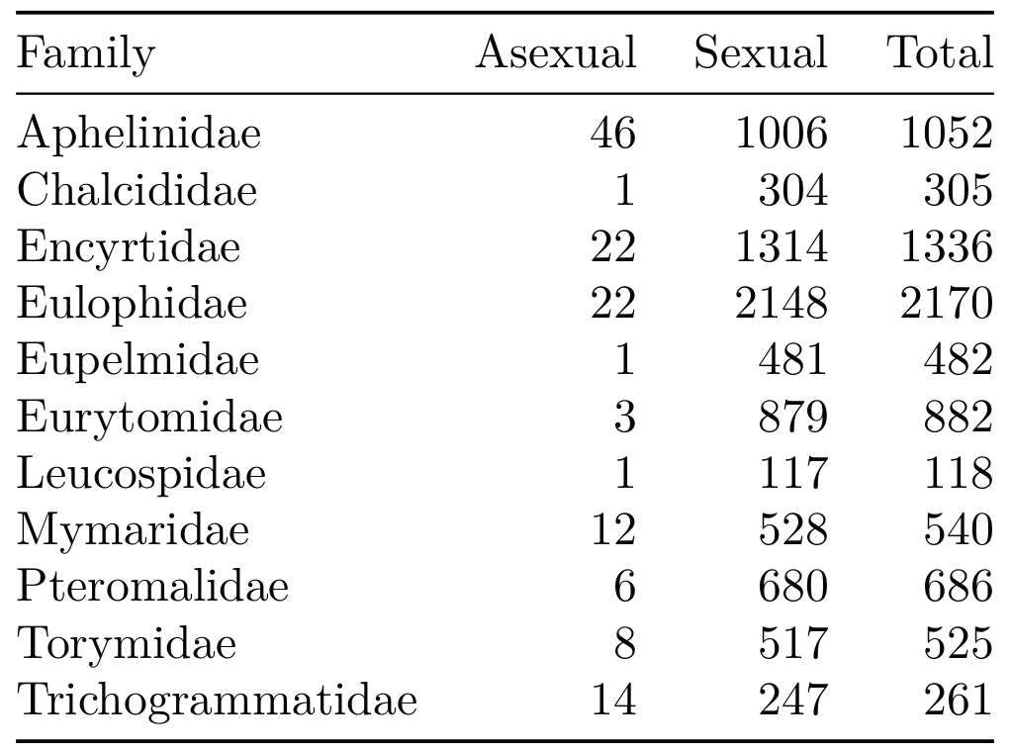
Automated dataset: Data

Slide 22
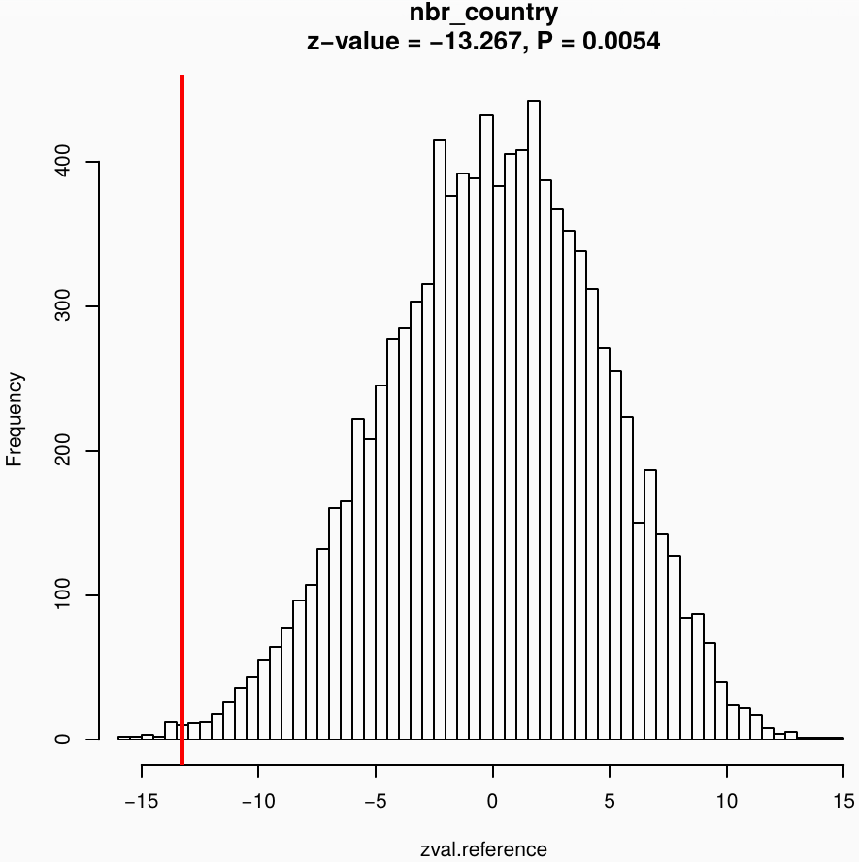
GLMM with permutation approach
Asex
Sex
model
Observed
statistic
observed
Genus
Random permutations
[...]
10,000 simulations
Reference
distribution

Slide 23
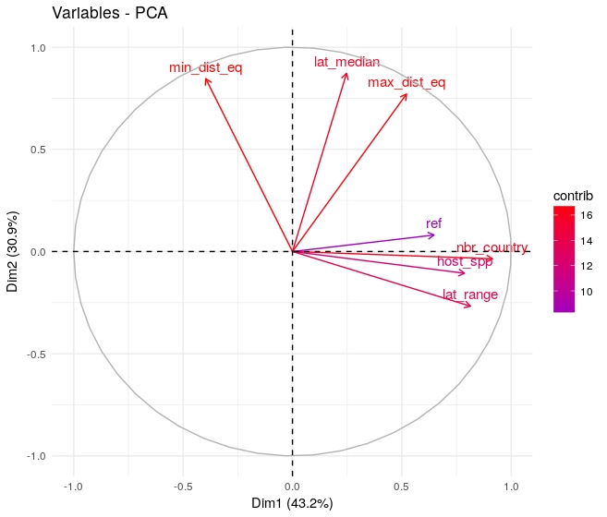
Automated dataset: Publication bias
Species with unknown reproductive mode considered sexual
Some variables strongly correlate with number of publications (ref)
Notes:
I WOULD REMOVE THIS SLIDE, I DON’T THINK THIS WILL HELP YOUR POINT (YOU HAVE VERY LITTLE TIME FOR QUESTIONS AND THIS SLIDE IS A BIT COMPLICATED)

Slide 24
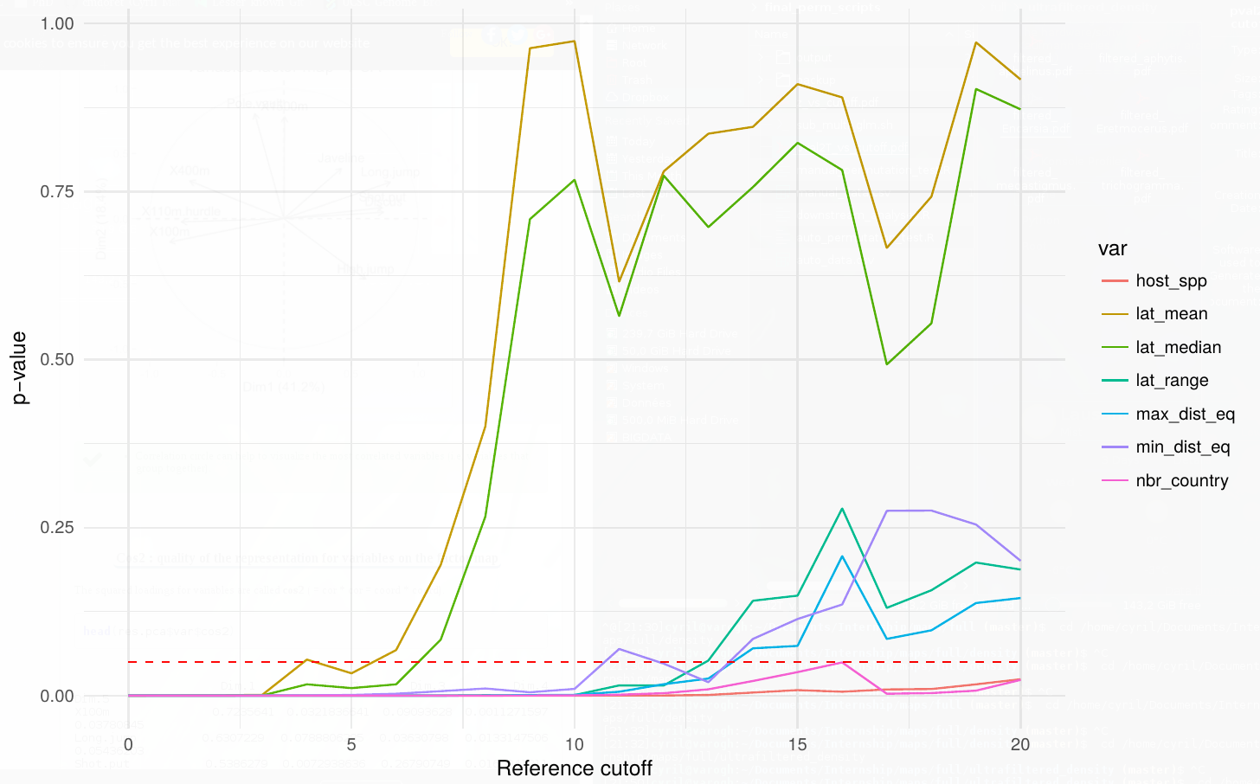
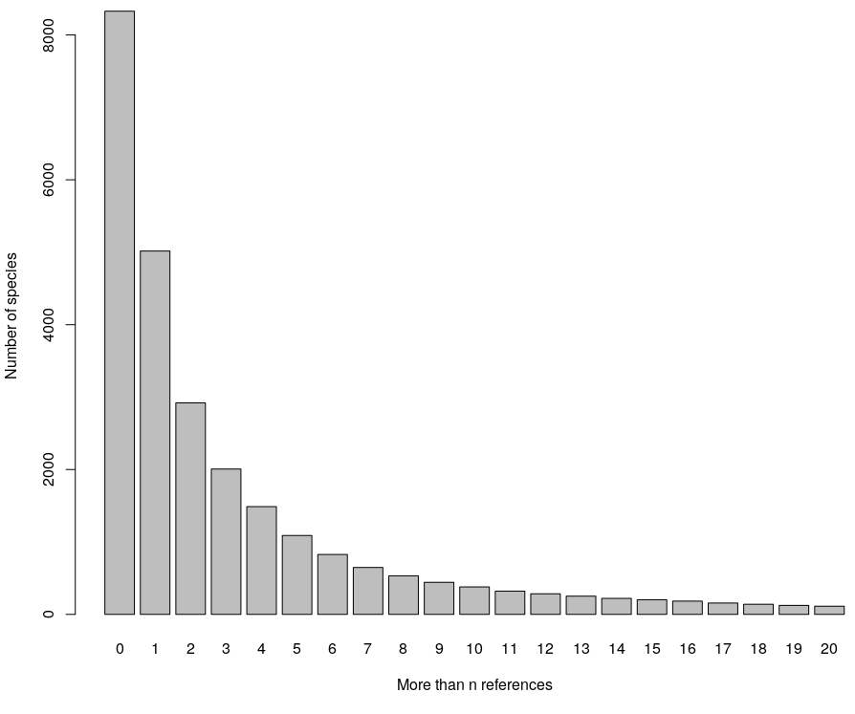
Automated dataset: Publication bias
Removing species with low number of publications
Trade off: bias vs power

